Slide 1


Data Analysis, Visualization and Predictive Analysis of CoVID-19 Pandemic Based on Total Infected Cases
Research Paper Presentation
Name of Presenter:
Samarth shukla
Co-Presentor : Abhishek Gupta, Ayush Srivastava , Aditya Srivastava

Slide 2

ABSTRACT
India reported its first confirmed case of the coronavirus infection on 30th January 2020 in the state province of Kerala. The infected had travelled back from Wuhan, China. As of June 5, a total of 6,861,716 global cases have been tracked and 236,657 cases along with 114,073 recoveries and 6,642 deaths across the country have been reported
The paper aims to bridge the gap between previous studies and the current evolution of CoVID-19 spreading, by drawing out a relationship between independent variables and dependent variables. This research statistically analyses the correlation among confirmed, recovered, death, and active cases globally which also involves state-wise and lockdown wise analysis of the Indian province
The paper suggests the predictive analysis with the help of DNN of the global confirmed and death cases with India as the index of research

Slide 3
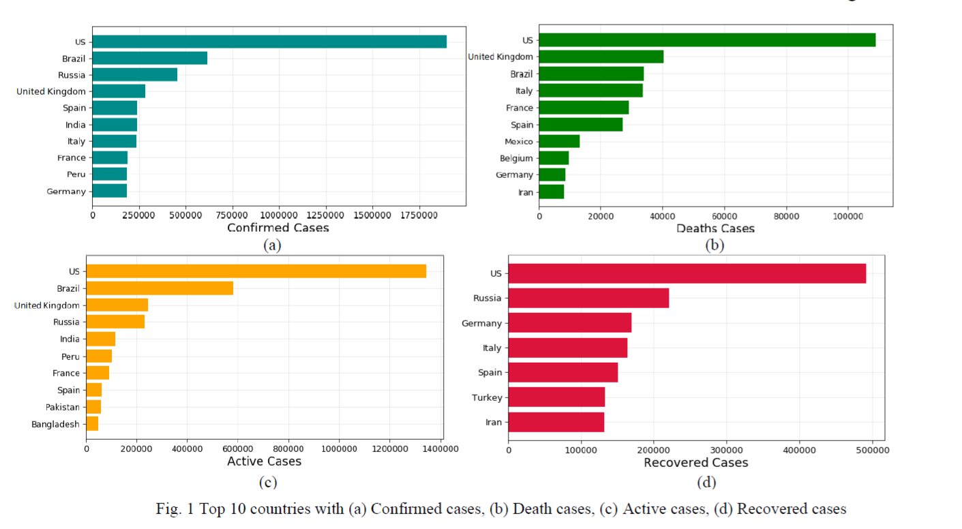
Introduction
CoVID-19 caused by severe acute respiratory syndrome coronavirus 2 (SARS-CoV-2) is an infectious disease originated from Wuhan, China. It has resulted in a declaration of an ongoing global pandemic by the World Health Organisation (WHO) on 11 March 2020.
The first case of CoVID-19 in India was reported on 30 January was a 20-year-old female student who returned from Wuhan [5]. It took rigorous efforts by our doctors and 17 days for her to recover. Coronavirus infected more than 2,36,656 cases in India by 5 June [3] while the global infected cases are 6,851,717. With this amount of cases, India has the largest number of confirmed cases in Asia and in the world, tally is at 6th position [2] surpassing Italy and with the current growth rate, is expected to surpass UK and Spain in few days
The research aims to study the data analysis and predictive analysis (with DNN) of coronavirus cases in World and as index country India based on real collected data and published reports. The main target is to study the effect of region and lockdown on the number of cases and giving a predictive analysis (with DNN) of the total number of confirmed cases, recovered cases and deaths worldwide and in India. Chi-Square Test is used to find the impact of the previous attributes on the number of recovered and deceased cases. The study would give an overview of the current situation in India besides, it may predict total cases and death cases by building the forecasting model

Slide 4
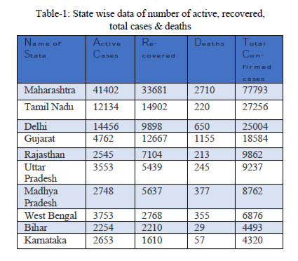
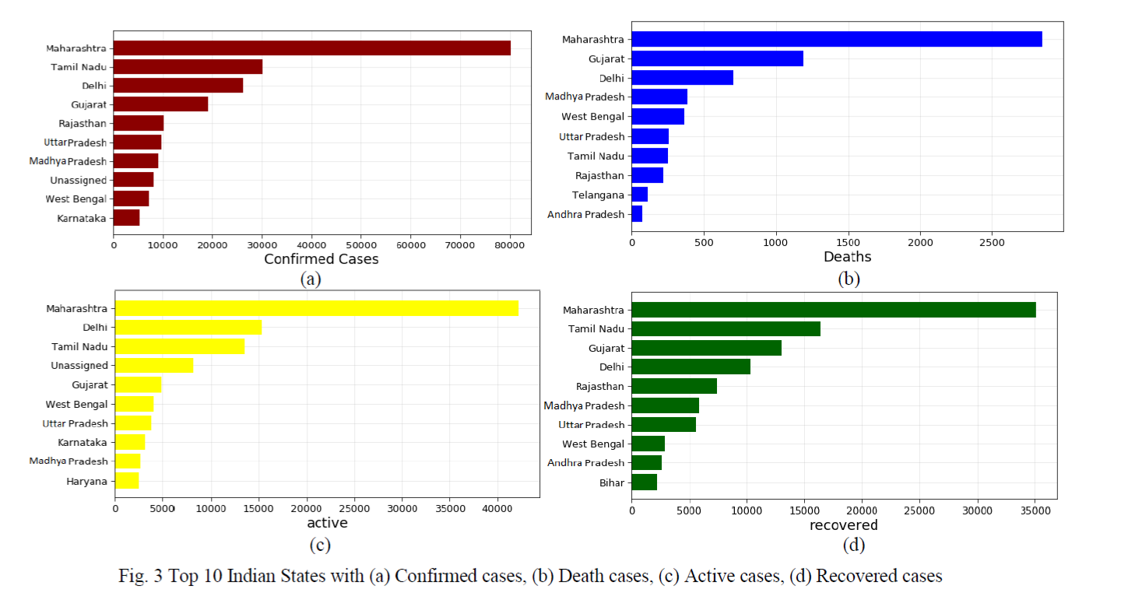
METHODOLOGY
For the analysis of data, the panda’s library (pd. read) for retrieval of data through a repository link was used Matplotlib library is used for plotting the data and NumPy library for calculation purposes. Since, this disease shows a non-linear structure of transmission thus severely affected countries and grounded them to lockdown
STATE-WISE ANALYSIS
Origination of CoVID-19 is from China and this disease transmitted by direct contacts hence, states of India which have international boarding got infected first with an increasing slope. This virus affects the immunity of the infected person and on analysis, it is found that aged and children are more prone to this disease . Table-1 shows a complete analysis of cases in different states. As shown in Maharashtra and Gujarat is on top as these states have international entrances.

Slide 5
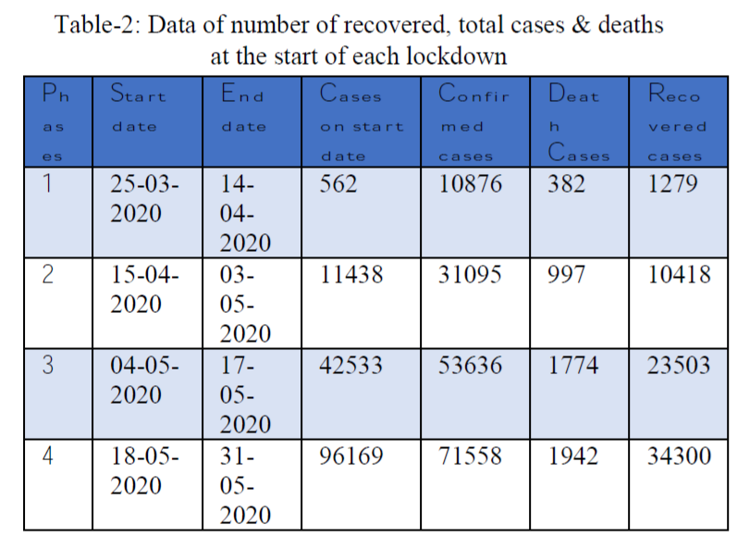
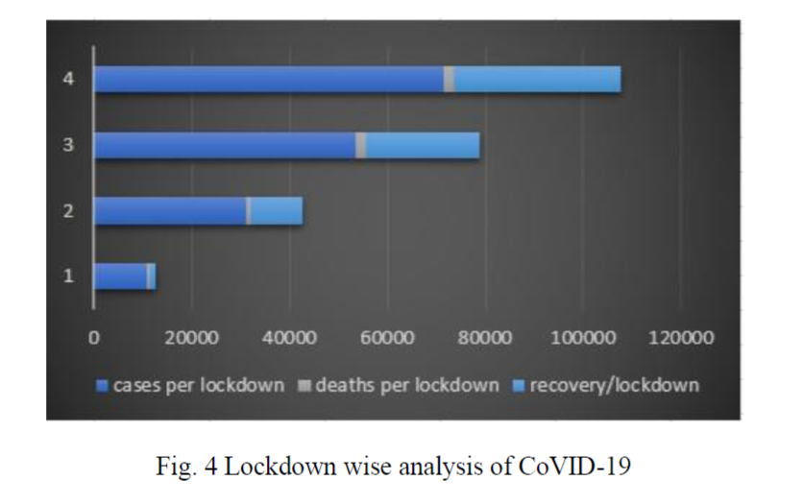
LOCKDOWN WISE ANALYSIS
The first lockdown implemented for 21 days impacted the country in various ways and ended with 10876 confirmed cases with 382 deaths and 1279 recovered in this phase only (Table-2) [3]. This is appreciable as India has 1.3 billion population [3], on 5 April 100 deaths were noted in the country
Now country issued 2nd phase of lockdown by 15 April (Table-2) [3] for 19 days and ended with 31095 confirmed cases, 957 deaths, 10418 recovered in this phase only (Table -2) [3]. Till now total tests were low and recovery rate was good.
The country has to face 3rd phase on 4 May (Table-2) for 14 days, the government tried to provide each and every hand to all people of the country but due to positive slope, this phase ended with 53636 confirmed cases, 1774 deaths and 23503 recovered in this phase (Table-2).
4th phase of lockdown started by 18 may (Table-2) for 14 days with the same strategy of zone division but ended with 71558 confirmed cases, 19484 deaths and 34300 recovered cases in this phase till 26 may (Table-2). By this time country has reached 1.5 lakh of confirmed cases [3] with more than 50,000 recovered cases .

Slide 6
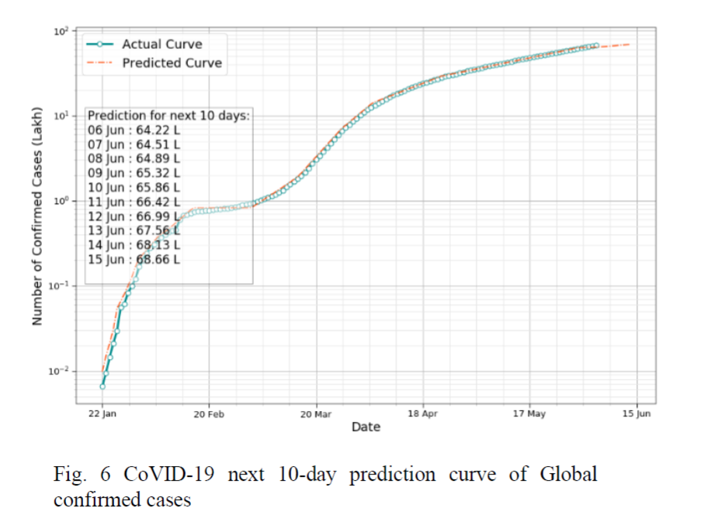
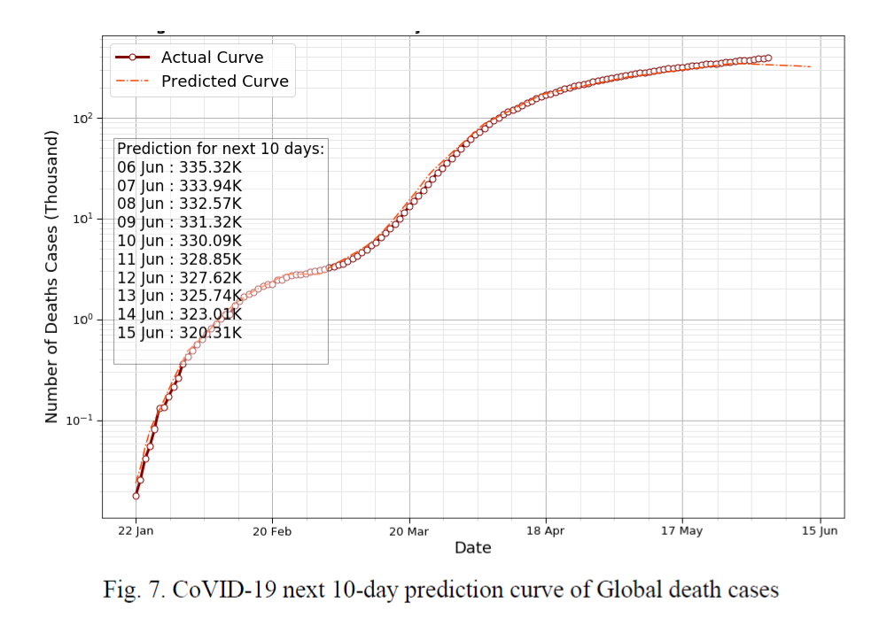
PREDICTIVE ANALYSIS OF CoVID-19
In this paper, deep learning for prediction was used. Deep learning consists of various type of neural networks which are categorized in supervised learning. Here Deep Neural network (DNN) was used, these are deep as they consist of many hidden layers where mathematical computation takes place for final output. In this paper, TensorFlow and Keras were used for building DNN. Additionally, L2 regularization was used to prevent the network from overfitting. Both tanh and relu activation are used with mean squared error and mean absolute error for compiling the model. Adam and RMSprop optimizers for the optimization of the model was imported.
PREDICTION OF GLOBAL CONFIRMED CASES AND DEATH CASES

Slide 7
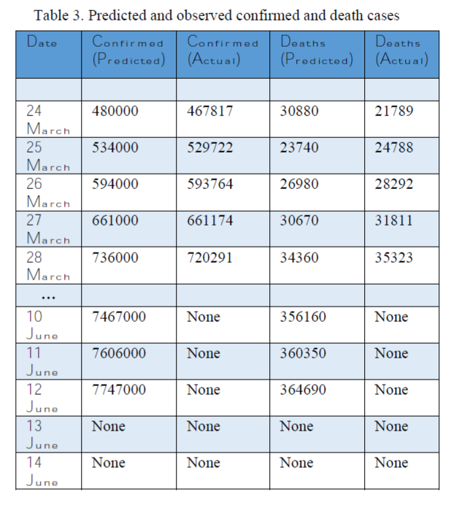
VERIFICATION OF MODEL
The table shown below has attributes of predicted and observed values in both confirmed and death cases.
Since, the global cases are increasing day per day and it is essential to know about some trends about the positive gradient of disease. A sequential DNN with 6 layers and 44,019 parameters was made, which were optimized through adam optimizer and loss is calculated by mean squared error. Layer 1,2,3,5,6 is regularized with L2(l=0.01) regularization for hyperparameter tuning of network. This network is trained on date wise sum of total confirmed cases from data obtained [1][6]. The activation function for the network is relu function which is trained for 2000 epochs .
Similar DNN is used for prediction of deaths and training data is obtained by summing deaths day per day. In this paper, prediction for the next 10 days was taken, and this can be changed by just changing the days in code . To check the accuracy of the model, some past known values were predicted as

Slide 8
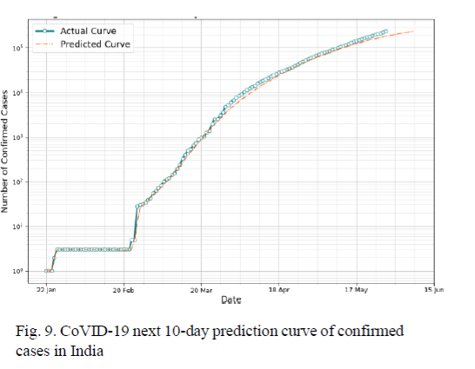
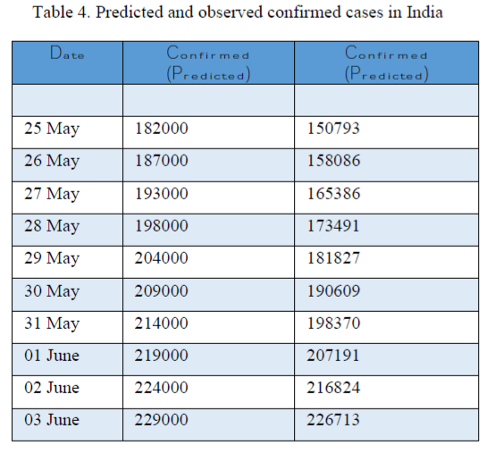
PREDICTION OF CONFIRMED CASES IN INDIA
A sequential DNN was made with 6 layers and 25,843 parameters which are optimized through RMSprop optimizer and loss is calculated by mean absolute error. Layer 1 is regularized with l2 (l=0.01) regularization and layer 3 is regularized with both l1 (l=0.001) and l2 (l=0.01) regularization for hyperparameter tuning of network. Dropout layers can be for preventing the overfitting of the network. This network is trained on date wise sum of total confirmed cases from data obtained [1][4][5]. Activation function for the network is relu function for all layers except layer 4 where tanh activation was used for involving values >0 and this model is trained for 3000 epochs
prediction for 10 days

Slide 9
CONCLUSION
The paper highlighted the analysis and visualization of data retrieved from sources to understand the spread of coronavirus infection. The predictive analysis done by building layers of sequential DNN resulted in understanding its future behavior related to the variables such as confirmed cases, deaths in the world as well as in India so that the preventive measures can be initiated as early as possible. The Chi-Square test confirmed the null hypothesis which sated that total confirmed cases are independent of the states/region in India The accuracy of the model is confirmed by the data provided from the past which resulted in the positive gradient; predicting the increase in the number of confirmed cases statistically. Variables that are considered in the hypothesis are region/state province of India. After discussing the obtained results, it was found that to mitigate the coronavirus disease in India, several procedures and prevention measures can be followed which will lead to a certain drop in the gradient that has been predicted by the model with an increase in the mortality rate

Slide 10
Refrences
[1] CoVID-19 Data Repository by the Center for Systems Science and Engineering (CSSE) at Johns Hopkins
[3] CoVID-19 India data available by Ministry of Health and Family Welfare (https://www.mohfw.gov.in/).
[4] CoVID-19 data api provide by GOI (https://api.rootnet.in/covid19-in/stats/testing/history).
[5] Gettleman, Jeffrey; Schultz, Kai (24 March 2020). "Modi Orders 3-Week Total Lockdown for All 1.3 Billion Indians". The New York Times. ISSN 0362-4331.
[6] CoVID-19 data used for predictive analysis through Kaggle (https://www.kaggle.com/).
[7] Al‐Rousan, Nadia, and Hazem Al‐Najjar. "Data Analysis of Coronavirus CoVID‐19 Epidemic in South Korea Based on Recovered and Death Cases." Journal of Medical Virology (2020).
[8] Yi, Huang, et al. "A study on deep neural networks framework." 2016 IEEE Advanced Information Management, Communicates, Electronic and Automation Control Conference (IMCEC). IEEE, 2016.
[9] Lai, Chih-Cheng, et al. "Severe acute respiratory syndrome coronavirus 2 (SARS-CoV-2) and corona virus disease-2019 (COVID-19): the epidemic and the challenges." International journal of antimicrobial agents (2020): 105924.
[10] Hamzah, FA Binti, et al. "CoronaTracker: worldwide COVID-19 outbreak data analysis and prediction." Bull World Health Organ 1 (2020): 32.
[11] "India most infected by Covid-19 among Asian countries, leaves Turkey behind". Hindustan Times. 29 May 2020. Retrieved 30 May 2020.
[12] Srivastava, Nitish, et al. "Dropout: a simple way to prevent neural networks from overfitting." The journal of machine learning research 15.1 (2014): 1929-1958.
For detailed information about the codes, statistics, figures and larger view of graph refer to the following link to reach the GitHub repository: https://github.com/Abhishek180007/covid-19-analysis

